Slide 1
HealthConnectPro
ER Diagrams

Slide 2
CS691 HealthConnectPro
List of Entities
Entity Name | Entity Primary Attributes
Patient | pid , pfirstname ,plastname, paddress, city, state, zipcode, pdob, pinsurance, ppolicy, pemail, ppassword,ptel
Doctor | docid, docname ,docemail, docpassword, doctel, sid
DiagnosticReport | reportid,reportdate,reporttype,testresult
Payment | paymentid, paymenttype, paymentdate,paymentamt
Advertisement | adid, adtitle,adcontent,adstartdate,adenddate
Appointment | appoid, apponum,appodate
Schedule | scheduleid,scheduletime,scheduledate, title, nop
AccountManagement | accountid,username,password,accountstatus,accountdesc
Specialties | sid, sname
MedicalRecord | mrid, mrdate,diagnosis, allergies, presciptionhistory

Slide 3
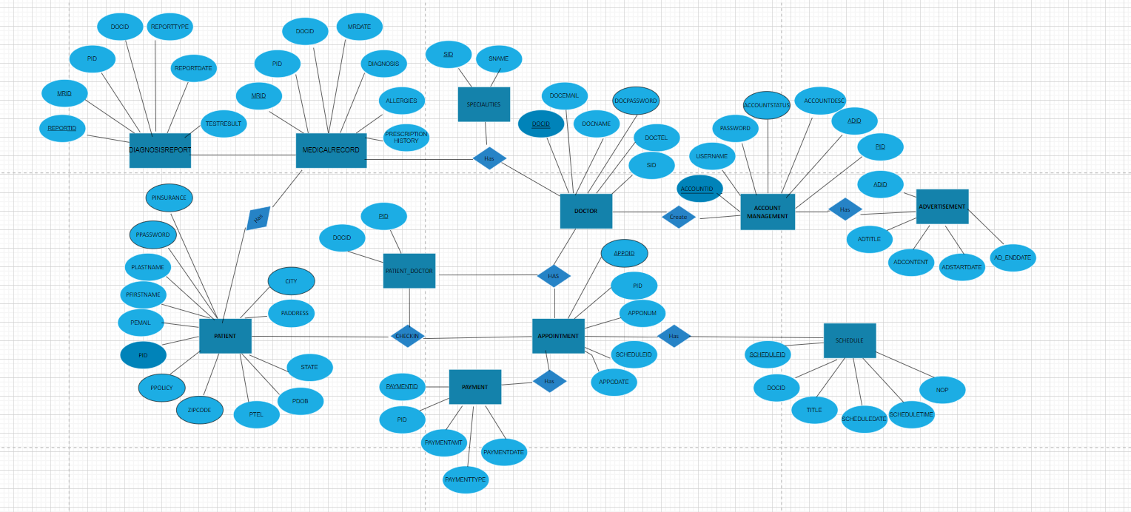
Conceptual ER Diagram

Slide 4
Logical ER Diagram

